Slide 1












Python Group Project
INDIA Tourism 2014-2020
Created by Group 8
Himanshu Sharma 2024H1540816P
Udip Patil 2024H1540811P
Sarthak Sarin 2024H1540812P
Abhishek Dubey 2024H1540813P

Slide 2








Table of Content
About Dataset
This dataset deals with the visitors to INDIA.
It includes foreigners, overseas Indians, and crew members, except for some of the foreign arrivals who are not
considered tourists (diplomats, soldiers, permanent residents, visiting cohabitation, and residents).
The Indian Government has compiled, analyzed, and provided statistics on foreign tourists visiting Indian
and overseas tourists by type.
The data materials were prepared for the purpose of utilizing them as basic data for establishing tourism policies and
marketing strategies.

Slide 3
Table of Content
Details of each excel file
Country Quarter Wise Visitors.csv: Percentage distribution of destination country-wise and departures of Indian nationals by quarter
Country Wise Age Group.csv: Nationality-wise FTAs in India by age group
Country Wise Airport.csv: FTAs (Foreign Tourist Arrivals) in India via major ports
Country Wise Gender.csv: Nationality-wise and gender-wise FTAs in India
Country Wise Visitors Ways.csv: FTAs in India by mode of travel
Country Wise Yearly Visitors.csv: Country-wise yearly visitors
General Data 2014-2020.csv: Tourist arrivals, revenue, and global tourism data (2014–2020)
Month Wise FTA.csv: Monthly arrivals of foreign tourists using e-tourist visas
Month Wise FEE Dollar.csv: Monthly Foreign Exchange Earnings (FEEs) in US $ billion from tourism
Top 10 Country FTA.csv: Top 10 source countries for FTAs in India
Top 10 State Visit.csv: Top 10 States/UTs by domestic tourist visits
Top 10 State FTA Visit.csv: Top 10 States/UTs by foreign tourist visits

Slide 4







Packages Imported
Python Libraries for Data Analysis and Visualization
File Handling:
from google.colab import files – Manage files in Google Colab.
Data Manipulation:
import pandas as pd – Work with structured data.
System Operations:
import os – File system interactions.
Numerical Computing:
import numpy as np – Mathematical operations on arrays.
Visualization:
import matplotlib.pyplot as plt – Static 2D plots.
import seaborn as sns – Advanced visualizations.
import plotly.express as px – Interactive charts and maps.

Slide 5







Data Analysis, Tidying, cleaning & verification
Each and every Excel file was analyzed, and columns were renamed.
Data Cleaning: Non-numeric placeholders were replaced with NaN, and missing values were removed.
Data Transformation & Standardization: Specific columns were converted to numeric values, and string inconsistencies were corrected. Applied corrections for consistency.
Data Conversion: Converted selected columns to numeric types for analysis.
Missing Value Handling: Dropped rows with missing values to ensure data completeness.
Data Validation & Verification: Rechecked structure and metadata after cleaning and conversion. The structure and data types were verified using info() to ensure the dataset was ready for analysis.

Slide 6






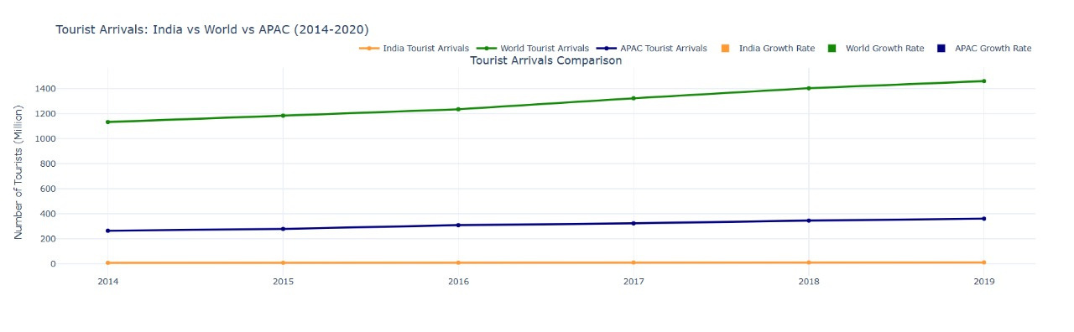



Insight 1.
Number of tourists arriving in India vs the number of tourists visiting the rest of the world and Asia Pacific region (APAC). This chart also shows growth rate of tourist in all 3 targeted area.

Slide 7
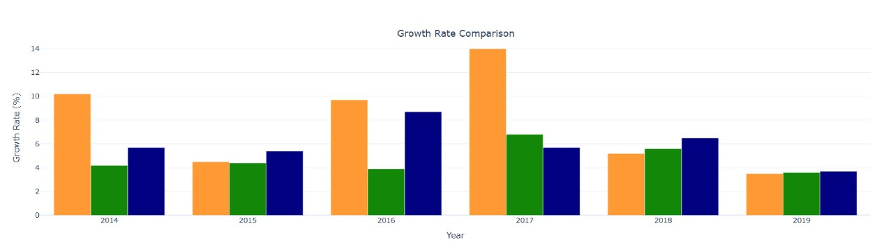
Insight 2.
This chart also shows Growth rate of tourist in India vs
the number of tourists visiting the rest of the world and Asia Pacific region (APAC).

Slide 8
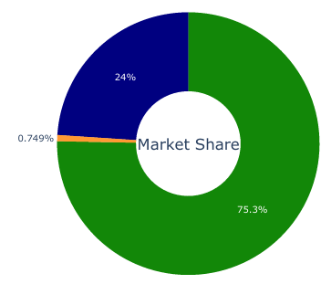
Insight 3.
This chart shows market share of Indian tourism Industry and APAC region vs the entire world.

Slide 9
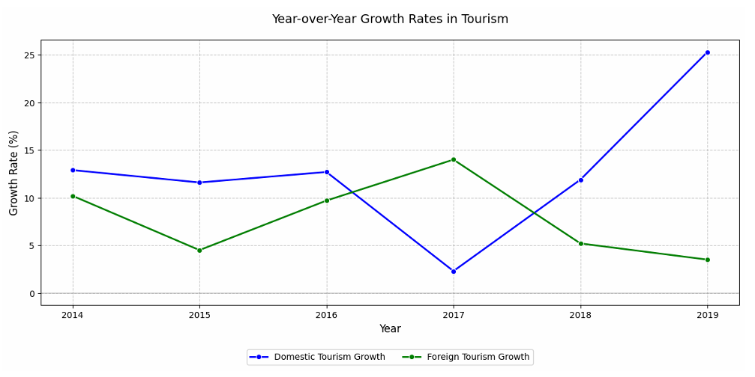
Insight 4.
Growth Rate of domestic tourists in India
vs
Growth rate of international tourist in India.

Slide 10
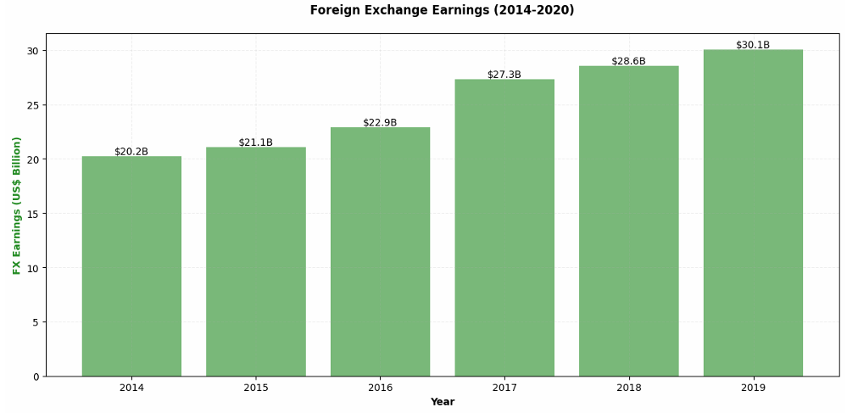
Insight 5.
Foreign Exchange earned by India due to tourism in US Dollar per year (2014-2019).

Slide 11
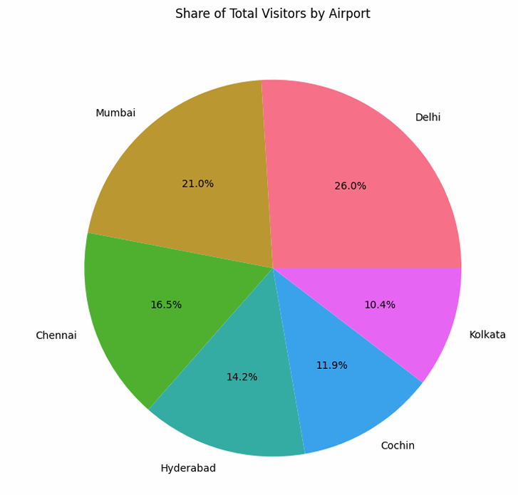
Insight 6.
Share of total visitors by top 6 Indian Airports

Slide 12
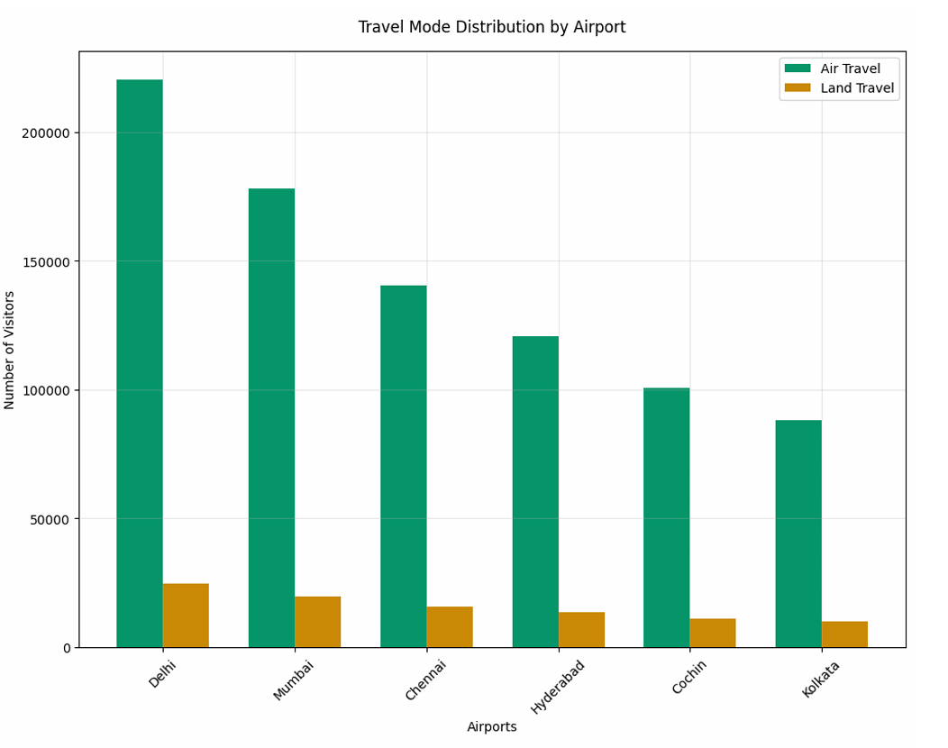
Insight 7.
Most popular mode of transport used by International tourists to visit India. (Air vs others)

Slide 13
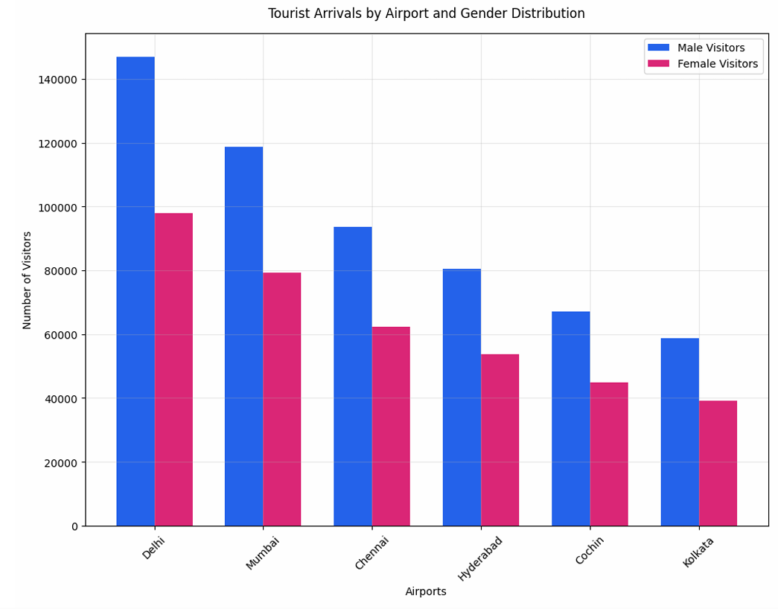
Insight 8.
Gender diversity of tourists arriving in top 6 Indian airports.

Slide 14
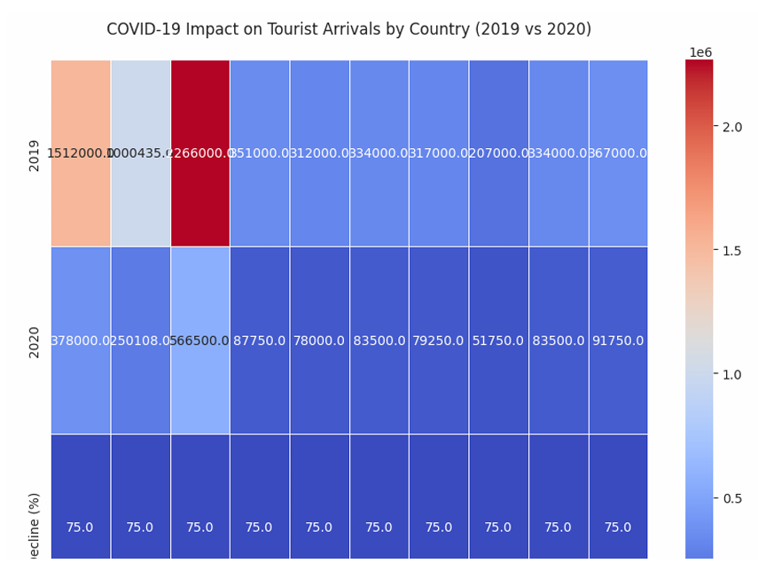
Insight 9.
Impact of COVID 19 on Indian tourism Industry (No of tourist travelling)
'USA' 'UK' 'Ban’ 'Can' 'China' 'Fran' 'Germ' 'Japan' 'Malay' 'Aus'

Slide 15




Thank You

